Slide 1

MOBILE application
Oneplus Store
Batch-86
Team-G
Parikipandla Mahesh
Prateek Sirvastava
Santhosh Kumar
Thanu Priya

Slide 2
CONTENTS
PROBLEM STATEMENT
SHORT DESCRIPTION
DESIGN
TECHNOLOGY USED
SCREEN SHOTS
CONCLUSION

Slide 3
PROBLEM STATEMENT
Oneplus store provides an easy way to sell products to a large customer base. However, there is a lot of competition among multiple Mobile selling sites. When users land on a Mobile selling site, they expect to find what they are looking for quickly and easily. They have a very broad idea about what they want to buy. The purpose our Oneplus website is to help customers narrow down their broad ideas and enable them to finalize the products.

Slide 4
SHORT DESCRIPTION
This project aims to develop mobile selling website for customers with the goal so that it is very easy to shop things from a extensive number on the web.
With the help of this you can carry out an online shopping from your home.
To get to this online shopping system all the customers will need to have a username and password to login proceed your shopping.
Once the user logins in successfully the user, the user can view the products and add them to cart.

Slide 5
TECHNOLOGY USED
React
HTML
CSS
BOOTSTRAP
SPRING BOOT
MY SQL

Slide 6
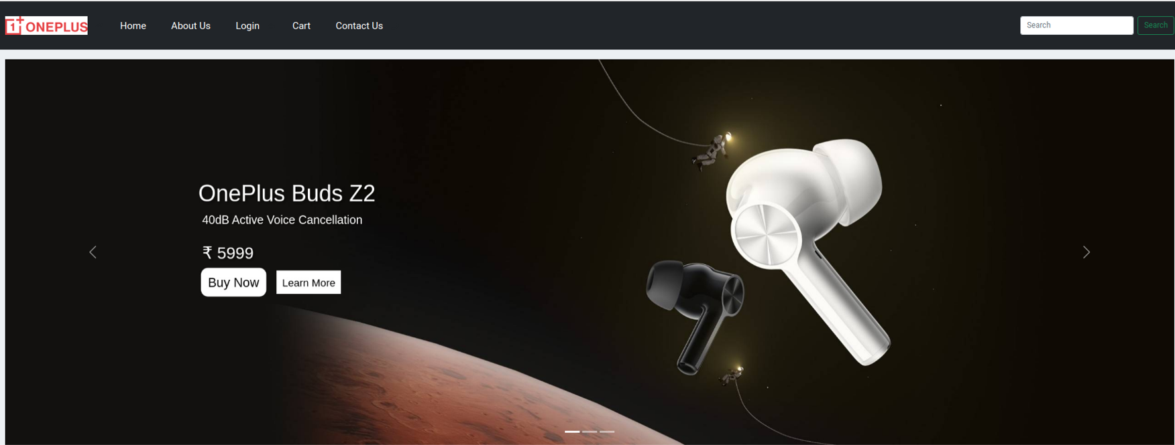

Slide 7
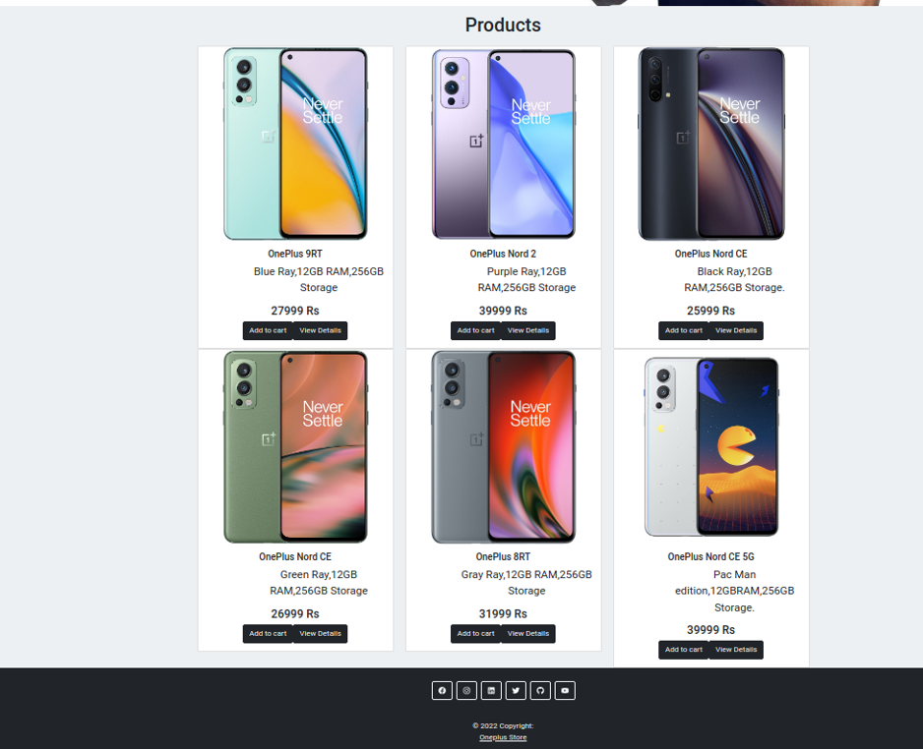

Slide 8
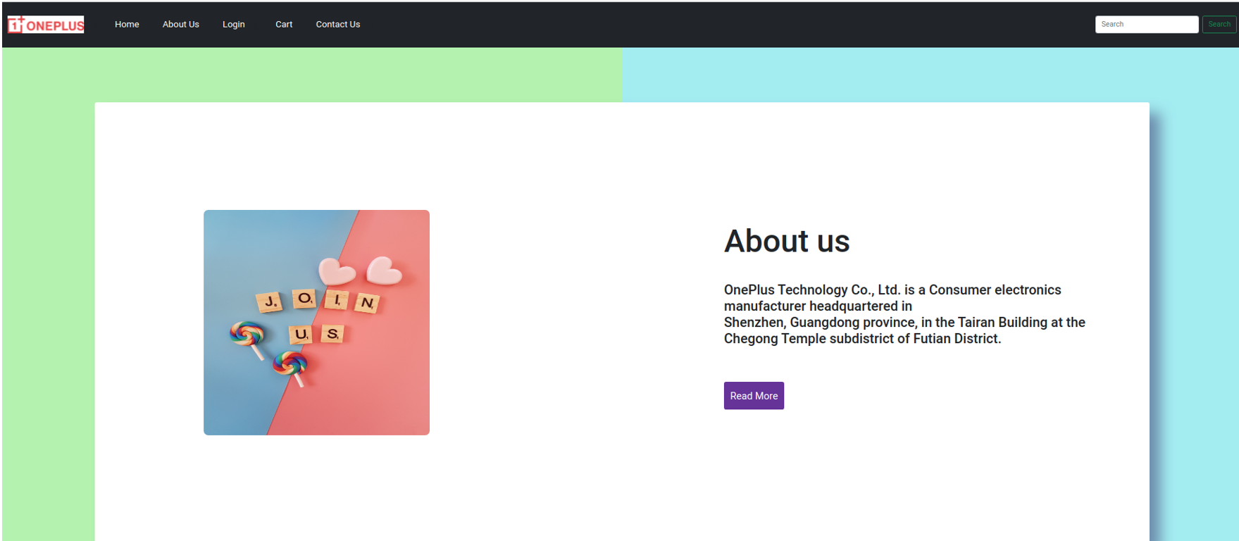
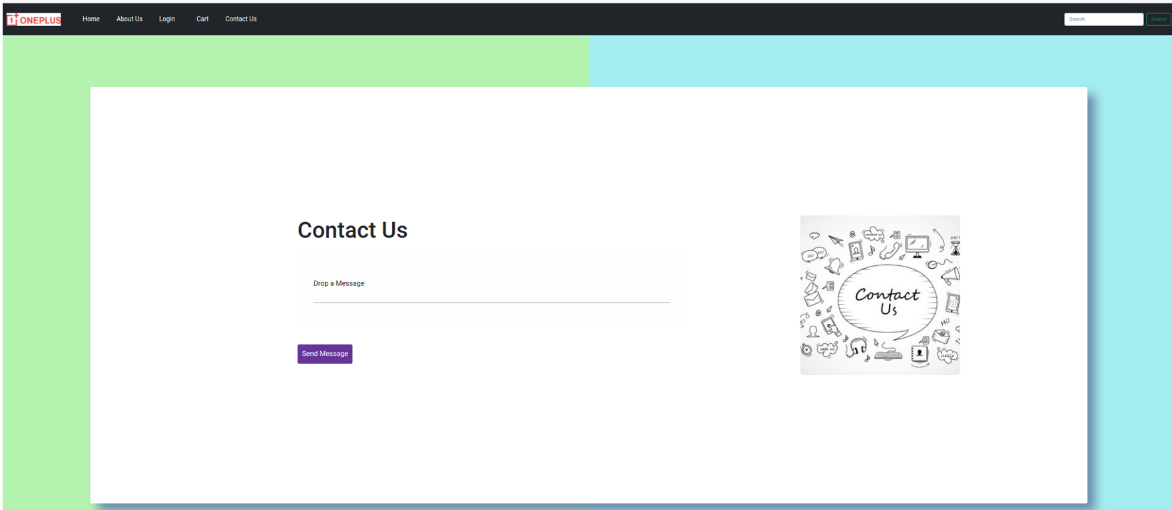

Slide 9
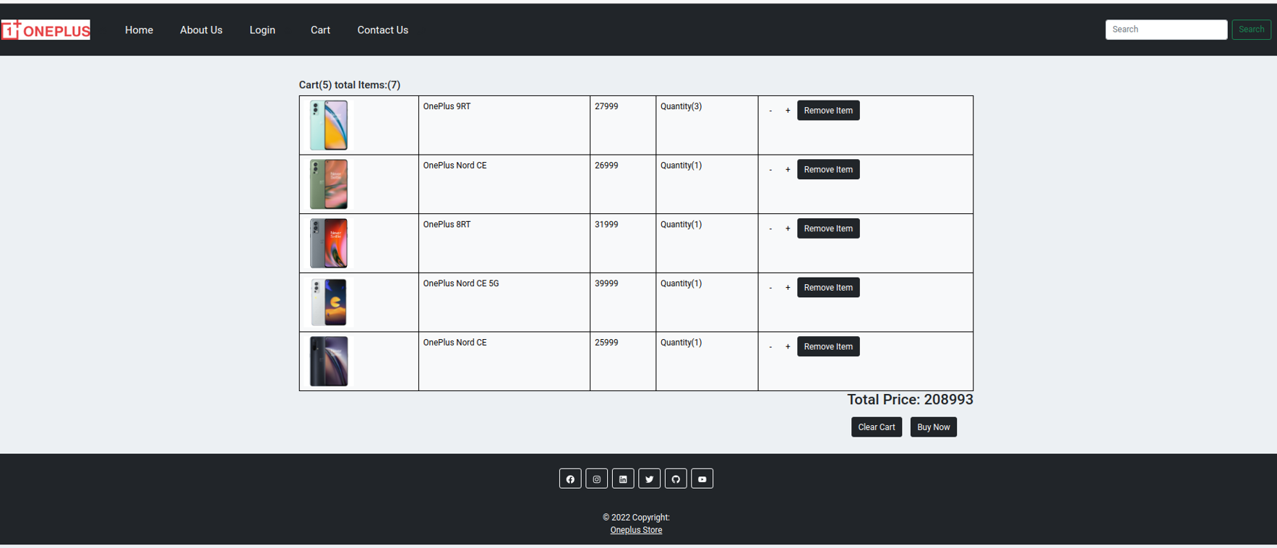
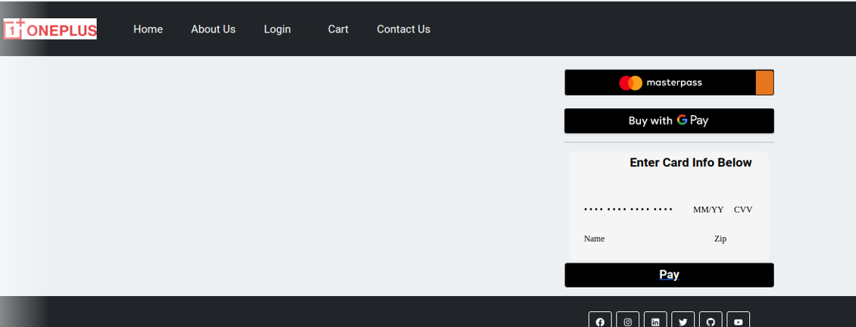

Slide 10
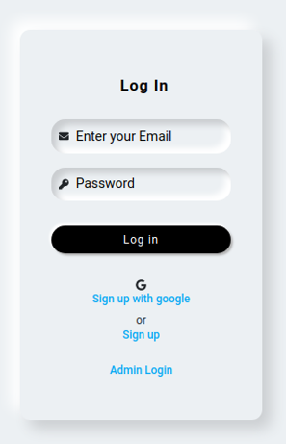
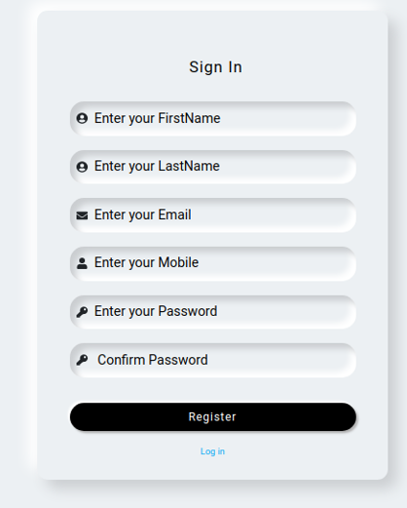
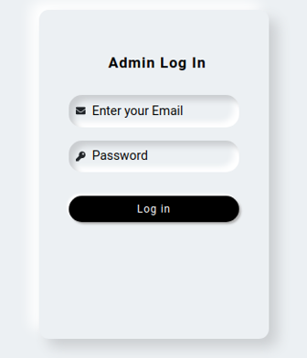

Slide 11
The mobile selling websites gives user an experience to shop sitting at one place and exposure to the wide range of products at one website.
We have used Html, Css and Bootstrap to design frontend.
And also used Java, Spring Boot for the Backend.
Mysql for storing the data.
The future enhancement is to make the website more secure, interactive and dynamic.
CONCLUSION

